Slide 1
Design Patterns

Slide 2
What is Design Patterns ?
Design Patterns are reusable solutions to the problems
Used to solve the problems of Object Generation and Integration

Slide 3
Types of Design Patterns
Gang of Four (GOF) categorized the Design Pattern into three main categories based on the three problem areas (Object Creation and Initialization, Structural Changes of Classes and Interfaces, and the Relationship Between Classes and communication Between Objects) of software architecture. They are as follows
Creational Design Pattern (Object Creation and Initialization)
Structural Design Pattern (Structural Changes of Classes, and Interfaces, and the Relationship Between Classes)
Behavioral Design Pattern (Communication Between Objects)

Slide 4
Creational Design Patterns
Helps us to centralize the object creation and initialization logic
It will create and initialize the appropriate object and return that object to the client
Then, the client can consume the object by calling the necessary methods and properties
The client does not know how the object is created and initialized

Slide 5
Creational Design Patterns
Singleton,
Factory,
Builder,
Prototype,
Abstract Factory

Slide 6
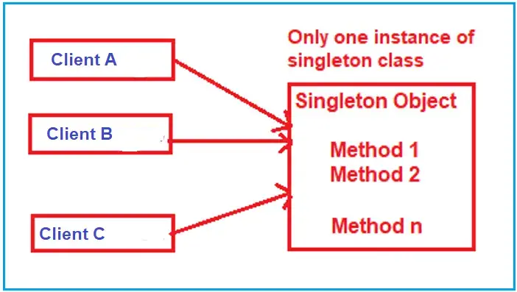
Singleton Pattern
Used to ensure that a class has only one instance and provides a global point of access to it.
When we need exactly one instance of a class to coordinate actions across the system

Slide 7
Key Characteristics of the Singleto
Single Instance
Global Access

Slide 8
Implementation steps of Singleton
Private Parameterless Constructor
Static Variable
Public Static Method or Property

Slide 9
Factory Design Pattern
A factory is an object used to create other objects.
In technical terms, a factory is a class with a method.
That method creates and returns different objects based on the received input parameter

Slide 10
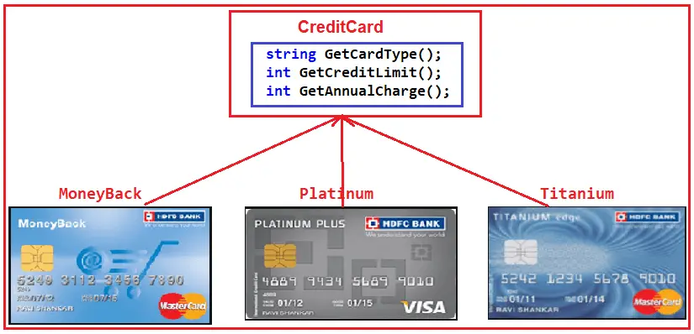
Real-Time Example to Understand Factory Design Pattern

Slide 11
Prototype Design Pattern
Prototype Design Pattern specifies the kind of objects to create using a prototypical instance and creates new objects by copying this prototype
That means it clones the existing object with its data into a new object. If we make any changes to the cloned object (i.e., new object), it does not affect the original object

Slide 12
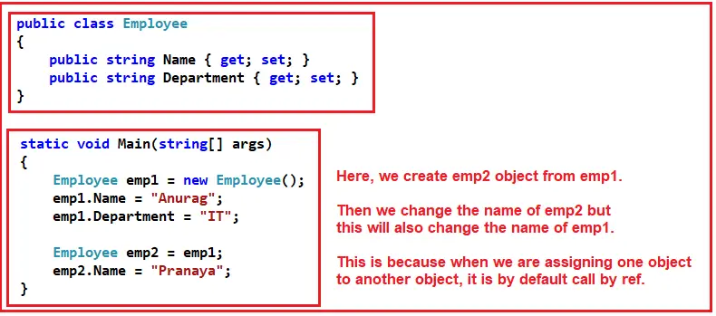
Problem statement

Slide 13
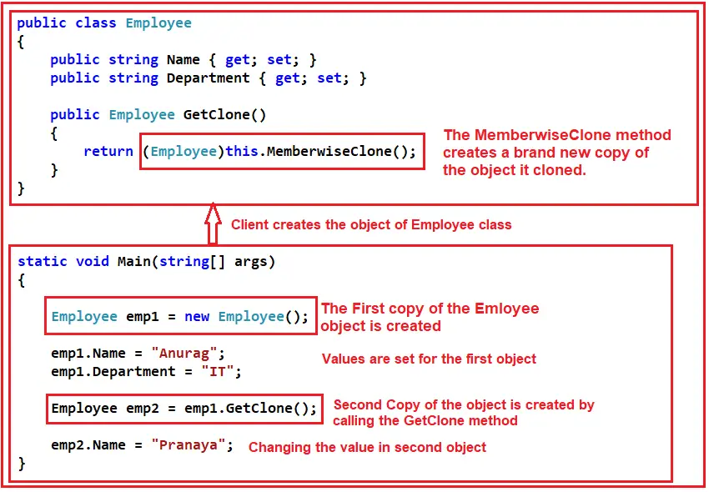
Prototype solution

Slide 14
When to use prototype?
when we want to create a Duplicate or Cloned Object from an Existing object to enhance the application’s performance
when creating an object is time-consuming, costly, and complex
Object Pooling: Real-time systems often use object pools (pre-instantiated objects ready to be reused) to manage resources efficiently, especially in high-load scenarios. The Prototype pattern can facilitate the management of such pools, allowing for the resetting and reusing of objects by cloning a clean prototype instead of recreating objects from scratch

Slide 15
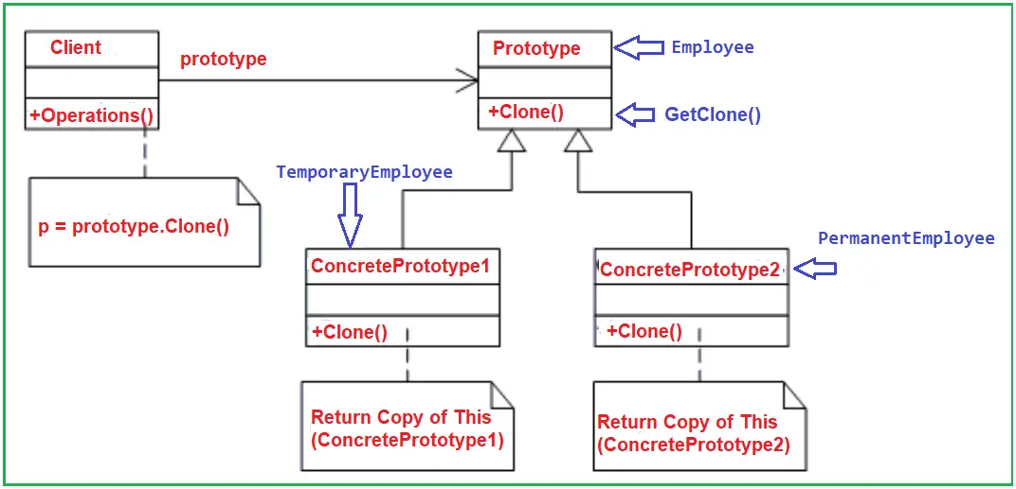

Slide 16
Builder design pattern
Builder Design Pattern builds a complex object using many simple objects and a step-by-step approach
The Process of constructing the complex object should be so generic that the same construction process can be used to create different representations of the same complex object.

Slide 17
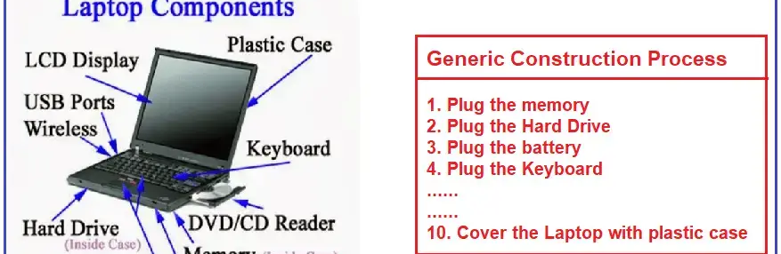
Process

Slide 18
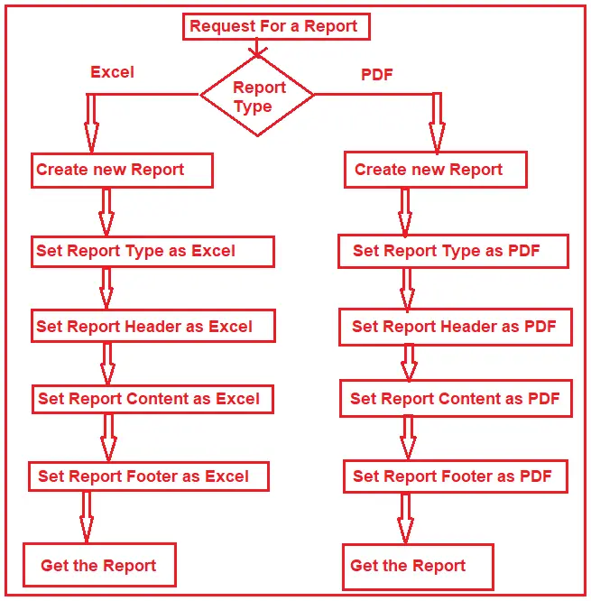
Understand Builder Design Pattern:

Slide 19
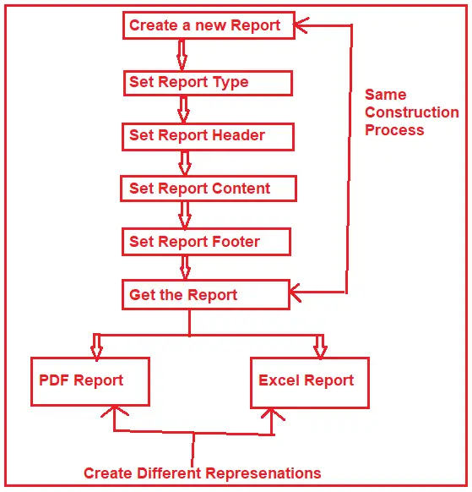
Final builder design output

Slide 20
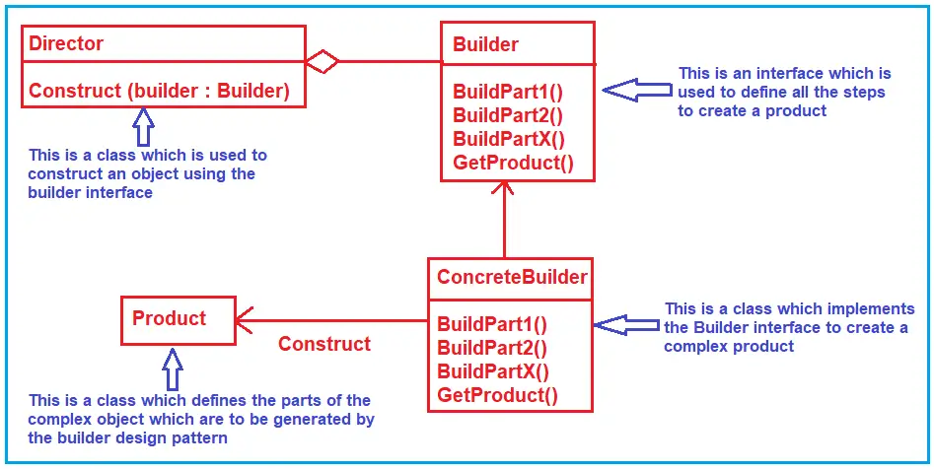
UML – Builder design

Slide 21
Structural Design patterns
The Structural Design Patterns simplify the design by identifying a simple way to manage the relationships between entities
In real-time applications, sometimes we need to change the structure of a class or the relationship among the classes, but we don’t want this change to be affected by the project

Slide 22
List of Structural Design Patterns.
Adapter Pattern
Bridge Pattern
Composite Pattern
Decorator Pattern
Facade Pattern
Flyweight Pattern
Proxy Pattern

Slide 23
What is the Adapter Design Pattern?
It allows objects with incompatible interfaces to work together
It acts as a bridge between two incompatible interfaces.
This pattern is useful when you want to use existing classes, but their interfaces do not match the one you need.

Slide 24
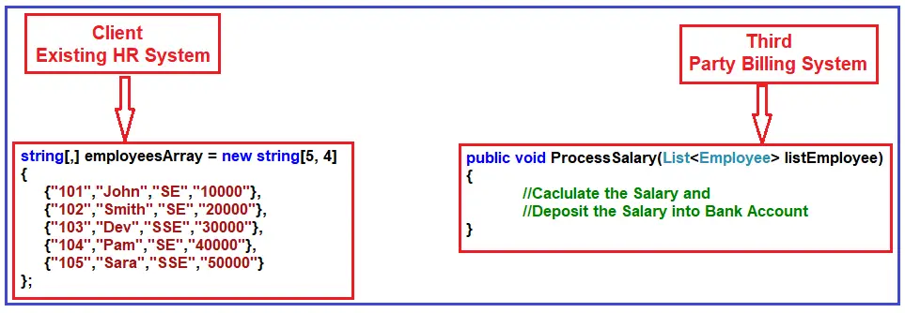
Example – Adapter design

Slide 25
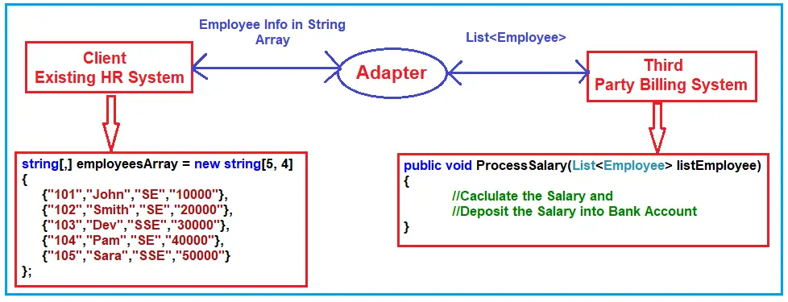

Slide 26
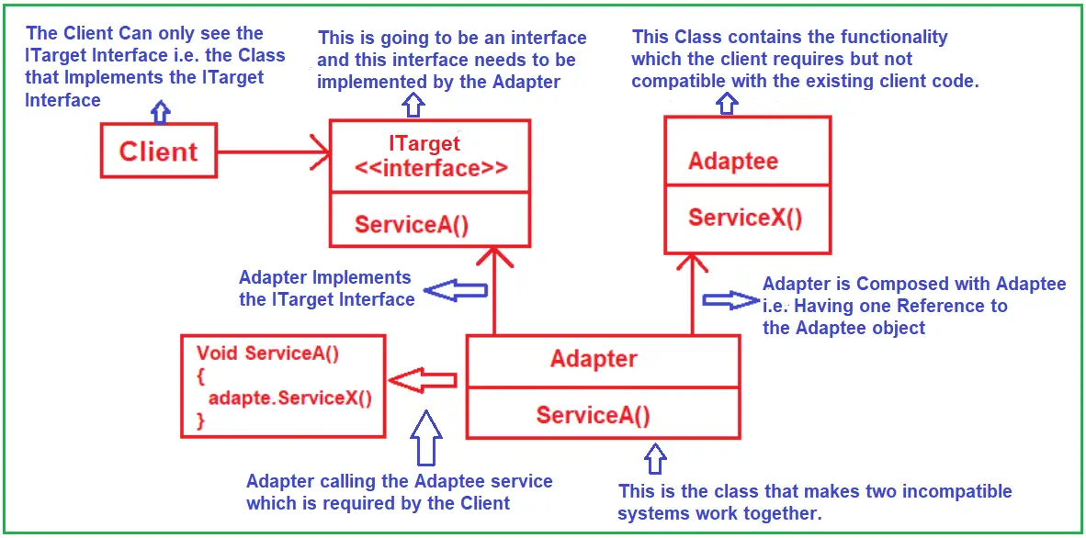
UML - Adapter

Slide 27
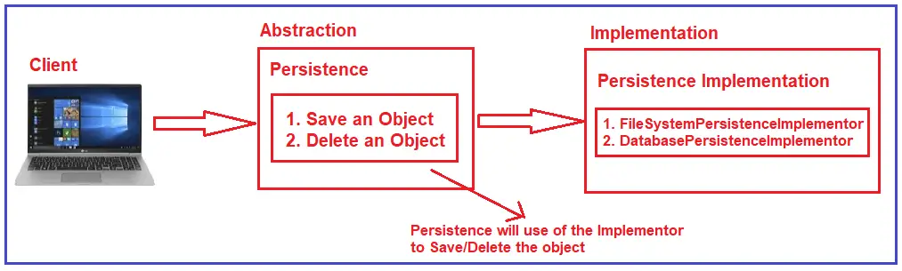
Bridge Design Pattern
Decouples an abstraction from its implementation so that the two can vary independently
This pattern involves an interface that acts as a bridge between the abstraction class and implementer classes

Slide 28
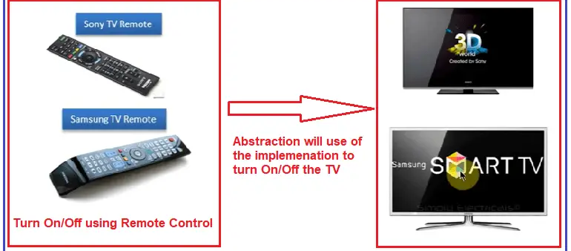
Example – Bridge design pattern

Slide 29
Composite Design Pattern
Compose objects into tree structures to represent part-whole hierarchies. Composite lets clients treat individual objects and compositions of objects uniformly

Slide 30
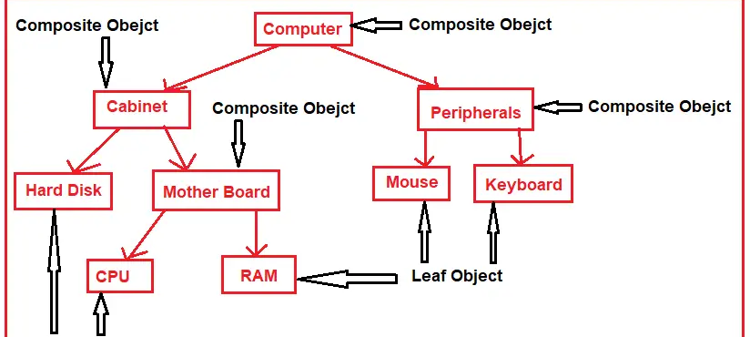
Example

Slide 31
Implementation of Composite Design Pattern
Component Interface: Define an interface or abstract class for implementing the composites and leaf nodes.
Leaf: Implement the component interface for the leaf nodes with no children.
Composite: Implement the component interface and also include a collection of components. The composite object can add, remove, and access the child components.
Client Code: The client works with all elements through the component interface.

Slide 32
Decorator Design Pattern
Allows us to dynamically add new functionalities to an existing object without altering or modifying its structure
This design pattern acts as a wrapper to the existing class
That means the Decorator Design Pattern dynamically changes the functionality of an object at runtime without impacting the existing functionality of the object

Slide 33
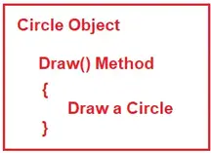
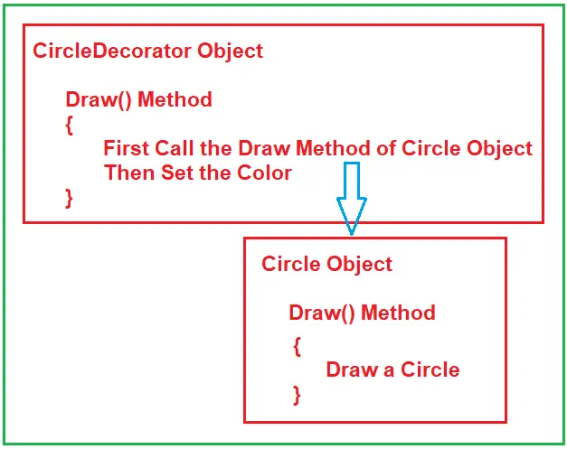
Example

Slide 34
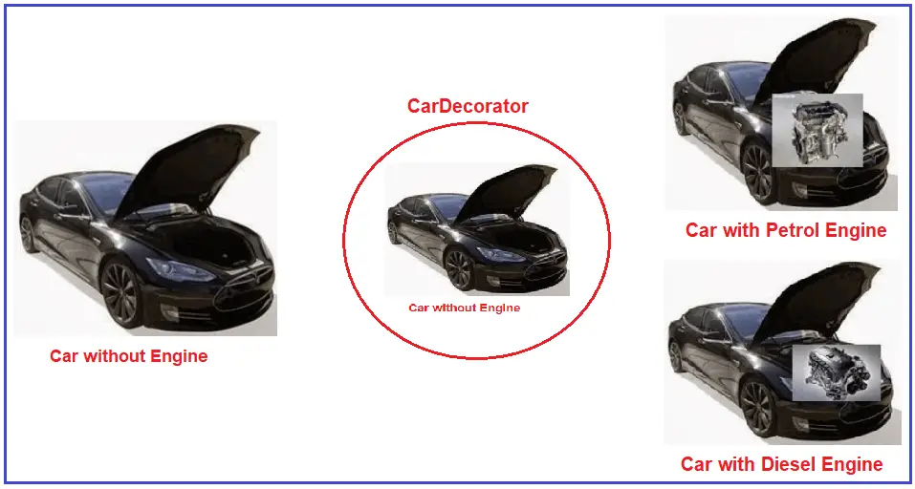
Example

Slide 35
Implementing the Decorator Design Pattern
Step 1: Creating the Car interface
Step 2: Creating Concrete Car
Step 3: Creating a Car Decorator
Step4: Creating Diesel Car Decorator
Step5: Creating Petrol Car Decorator
Step6: Client code

Slide 36
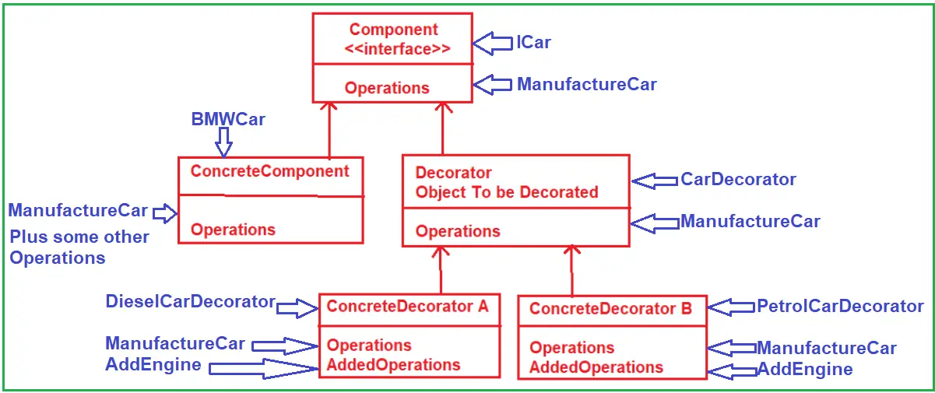
UML – Decorator design

Slide 37
Advantages of Decorator Design Pattern:
Flexibility: Provides a more flexible way to add object responsibilities than static inheritance.
Dynamic Responsibilities: You can add or remove responsibilities from an object at runtime.
Functionality Layering: Allows for the layering of functionalities. Each decorator adds its behavior before and/or after delegating the task to the base component.
Single Responsibility Principle: Promotes smaller, cohesive classes that each handle one responsibility.

Slide 38
Proxy Design Pattern
Proxy Design Pattern provides a surrogate (act on behalf of another) or placeholder for another object to control access to it
The proxy could interface with anything, such as a network connection, a large object in memory, a file, or other resources that are expensive or impossible to duplicate.

Slide 39
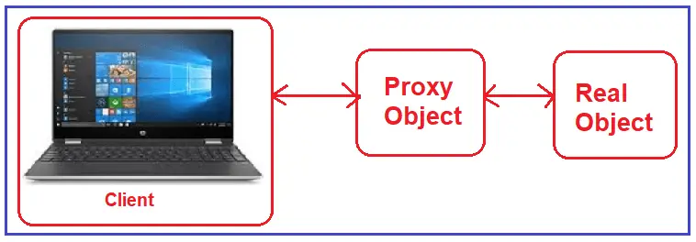
Example

Slide 40
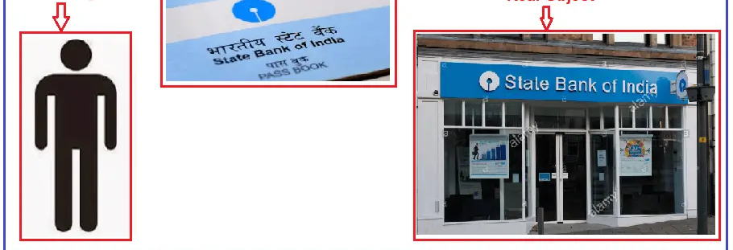
Example

Slide 41
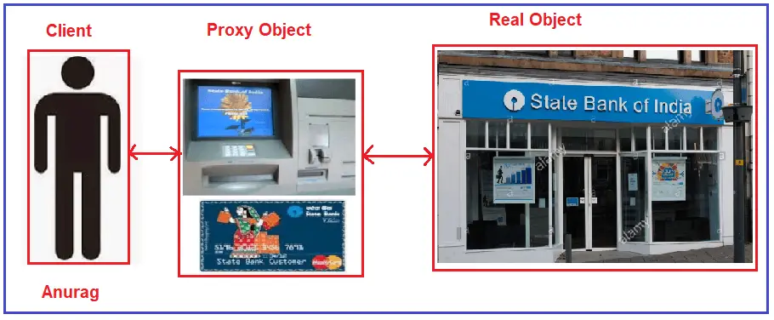
Example

Slide 42
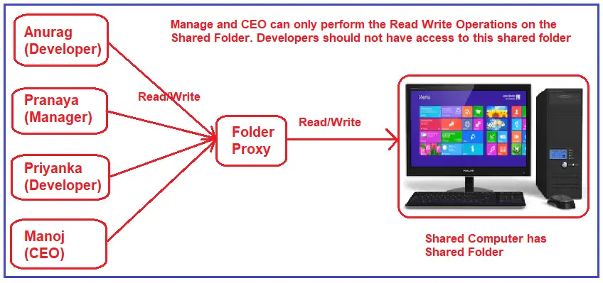
Example

Slide 43
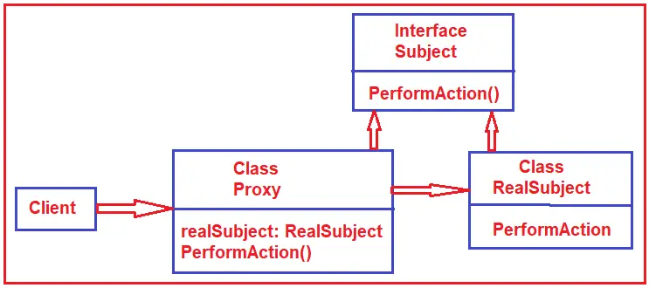
UML - Proxy

Slide 44
Facade Design Pattern
Facade Design Pattern states that you need to provide a unified interface to a set of interfaces in a subsystem. The Facade Design Pattern defines a higher-level interface that makes the subsystem easier to use.

Slide 45
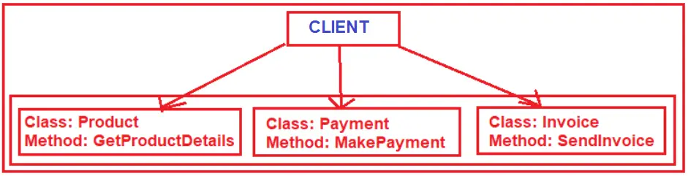

Slide 46
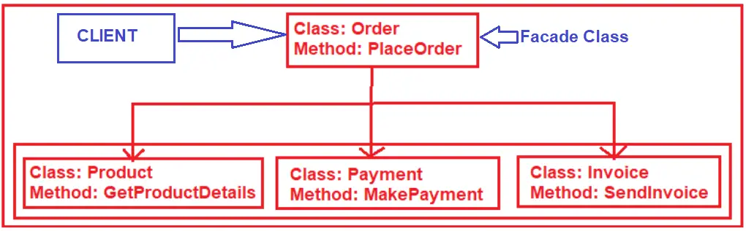

Slide 47
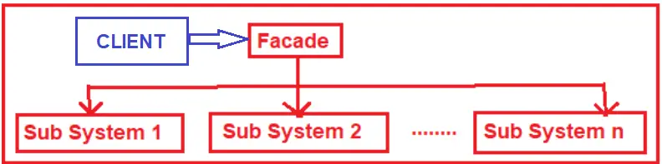
UML - facade

